Slide 1
Medical Funds in a changing world
Rajesh Patel BHF
July 2018
NAMAF Trustee Training

Slide 3
Outline
Business of health fund
Health Governance
Progressive health policy
Standardised benefits
Resources

Slide 4
Business of Medical Fund
Purpose of MF
Why do employers plough millions for staff?
Business of Health!

Slide 5
Health Governance
Health needs
Health benefits/services
Interventions
Problems identified
Health priorities
M&E
Progressive health policies

Slide 6
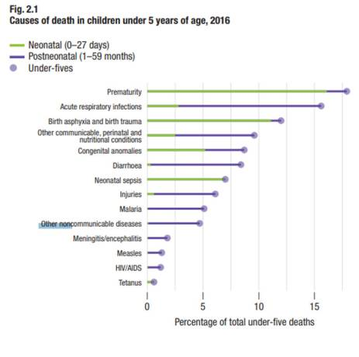
<5year Mortality: scheme X

Slide 7
Access to essentials medicines:
Inadequate health governance throughout the value chain!
Finance centric rather than health centric!
 |  | 2010 | 2011 | 2012 | 2013 | 2014
IHD | Aspirin Cover % | 61 | 57 | 63 | 62 | 60
 | Statin coverage % | 67 | 59 | 59 | 59 | 58
Diabetes I & II | Statin coverage % | 40 | 34 | 35 | 37 | 38
Cardiac Failure | ACE/ARB Cover % | 65 | 62 | 60 | 60 | 59
Source: HQA 2015 reports

Slide 8
Context that informs policy!
Social Solidarity
Community Rating
Mandatory membership of sorts
Affordable Access to Care
UN & WHO
SDGs
NHI
UHC
Access to meds & vaccines

Slide 9
Progressive health policies
Social solidarity
Cross subsidisation
Community rating
Contribution level
Benefit level
Prescribed benefits
Prescribed pricing
Strategic purchasing
Compete on quality and outcomes
Reduced fragmentation
UHC
Information asymmetry
Financial
Risk based capital
Anti-selection protection

Slide 10
UHC

Slide 11
Effective Coverage
Assess progress towards UHC
http://journals.plos.org/plosmedicine/article?id=10.1371/journal.pmed.1001730
Presented as a percentage
Unmet need
Use (Intervention/Drug)
Quality/Outcomes

Slide 12
Standard benefits structure for Social Solidarity
Revised PMB Benefits
Top-Up A
Top-up B
Top-up C

Slide 13
New PMB
All public sector care & emergency services
Incl. Primary care
Consultation services
Evidence based preventive care
Formulary of procedures, radiology, pathology
Medicine: EDL
Essential devices
Essential dental care
Optical benefit subject to resolution of perverse pricing
Rare diseases & Biologics benefits (PMB)
Center of Excellence & Repricing considerations

Slide 14
Regulatory reform
Supply side reform
Co-ordinated care & Group practices
Quality and outcomes improvement
ARMs
Funder side reform
Voluntary changes
Regulatory changes

Slide 15
Resources: penny wise and pound foolish
Medical advisors
Public Health expertise
Health economists
HTA
Health promotion expertise
Ethical leadership

Slide 16
Video

Slide 17
THANK YOU

